Slide 1
UNIT-5 BIOMATERIALS
REGENERATIVE MEDICINE

Slide 2
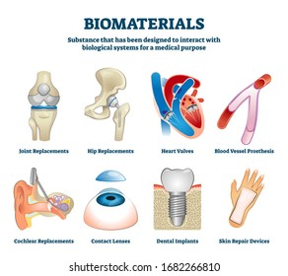
Biomaterials
Definition
History
Types
Materials
Characteristics
Biocompatibility
Applications
Future scope
References

Slide 3
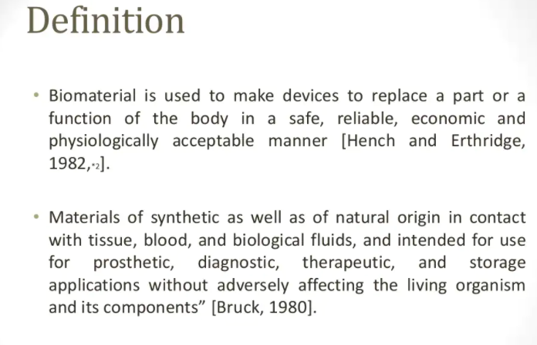
Definition

Slide 4
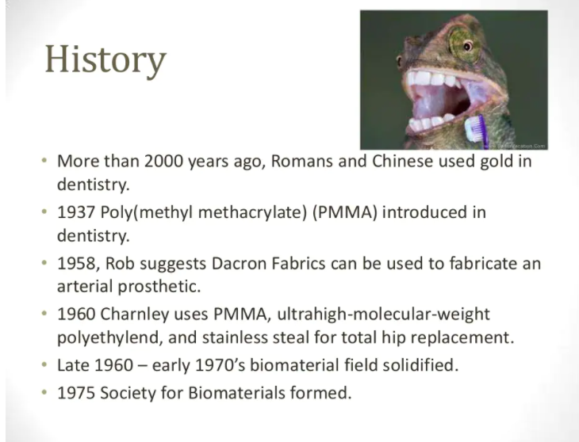

Slide 5
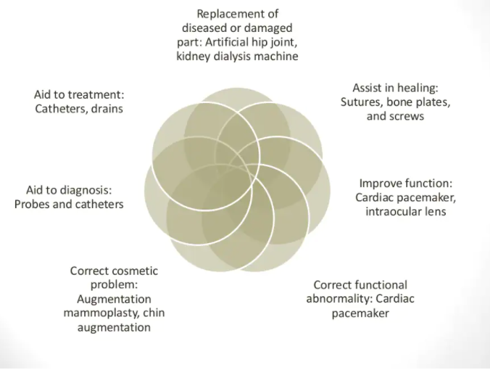
USES OF BIOMATERIALS

Slide 6
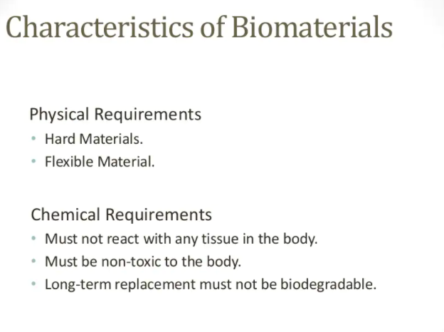

Slide 7
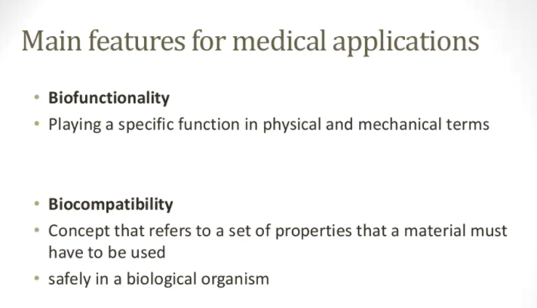

Slide 8
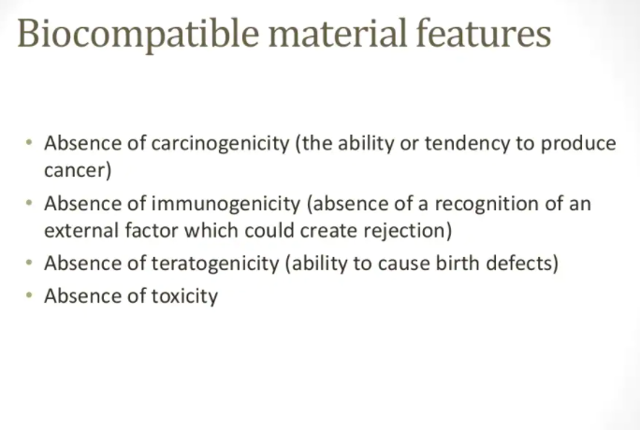

Slide 9
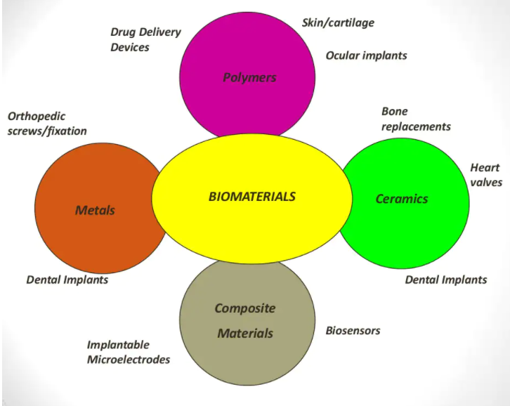

Slide 10
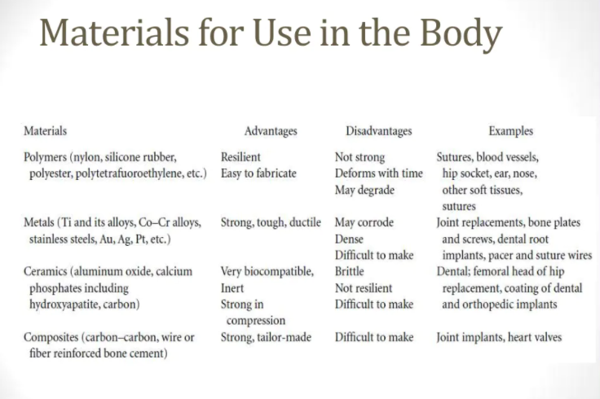

Slide 11
CLASSIFICATION OF BIOMATERIALS
FIRST GENERATION
SECOND GENERATION
THIRD GENERATION
BIOINERT
BIOACTIVE
BIORESORBABLE

Slide 12
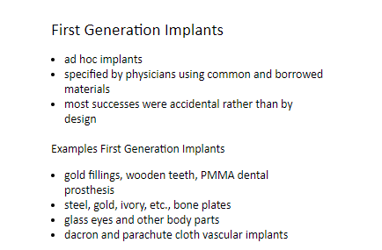
TYPES- FIRST GENERATION

Slide 13

SECOND GENERATION IMPLANTS

Slide 14

THIRD GENERATION

Slide 15
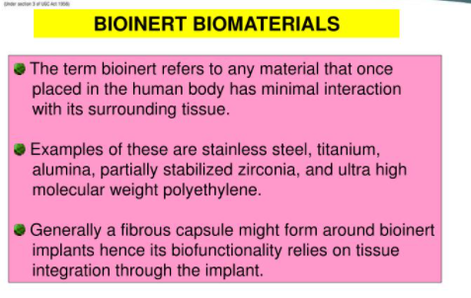

Slide 16
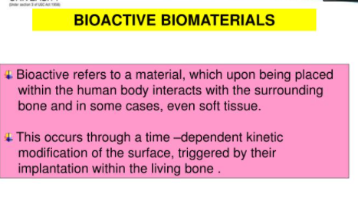

Slide 17
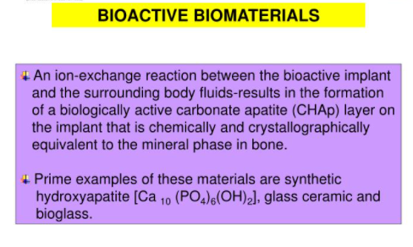

Slide 18


Slide 19
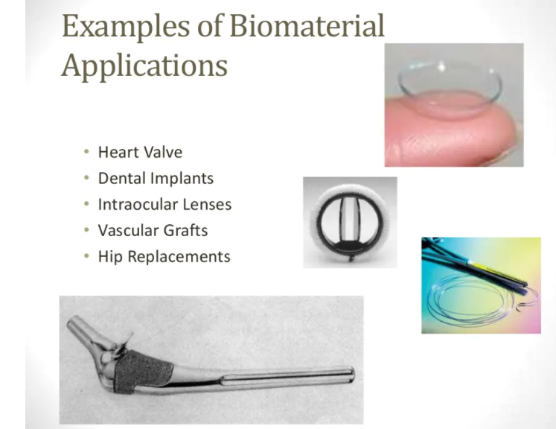

Slide 20
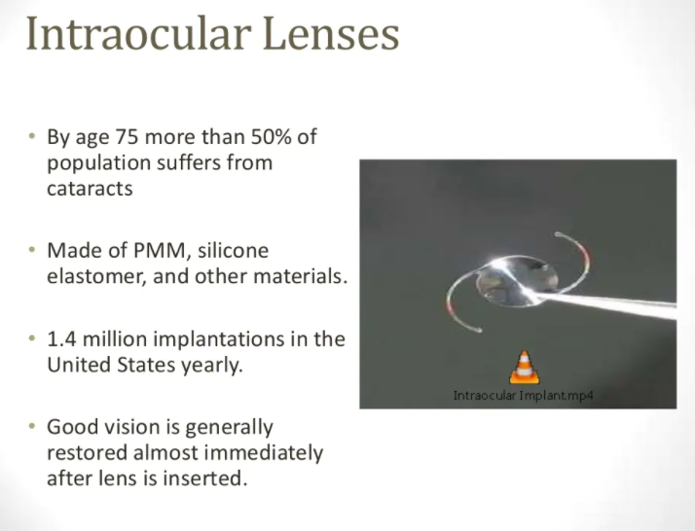
Poly (methyl methacrylate) (PMMA) belongs to a group of materials called engineering plastics. It is a transparent thermoplastic.

Slide 21
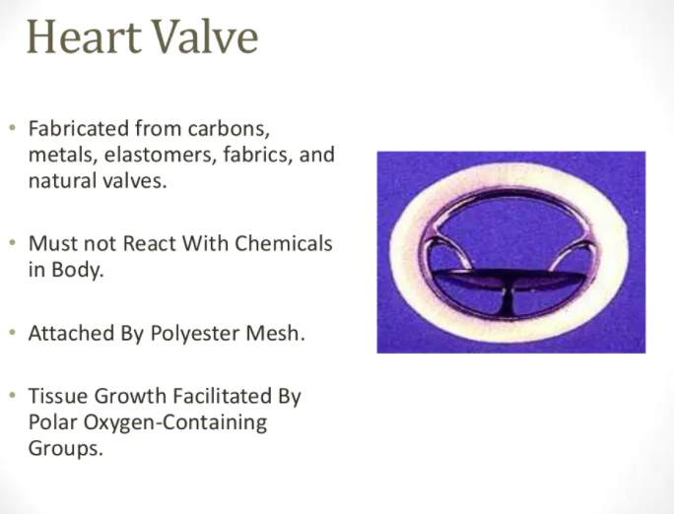

Slide 22
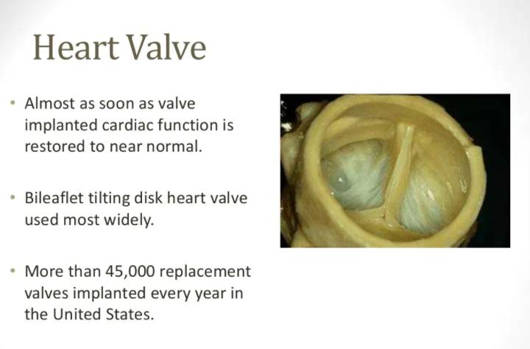

Slide 23
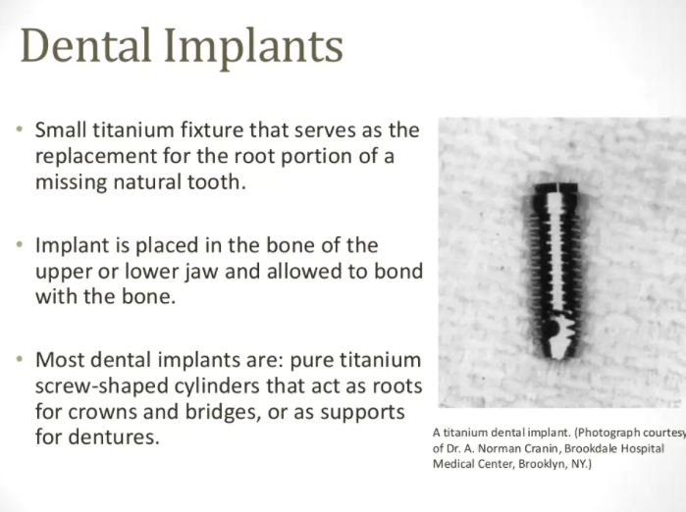

Slide 24
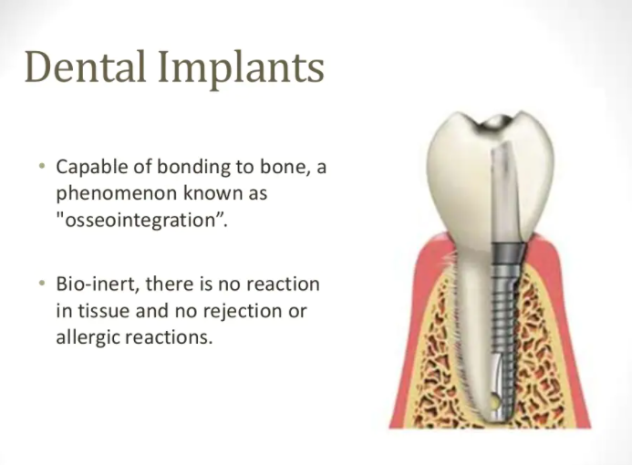

Slide 25
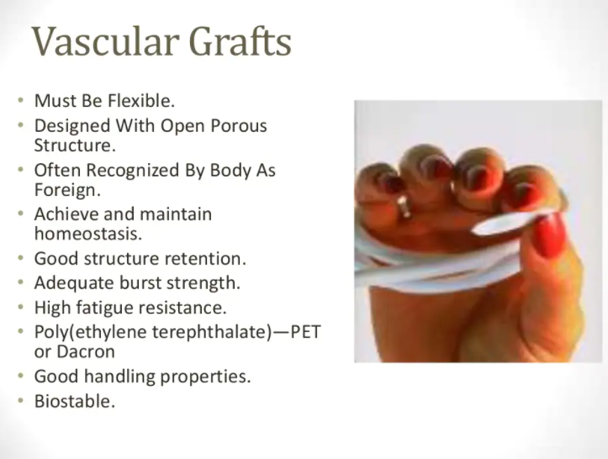

Slide 26
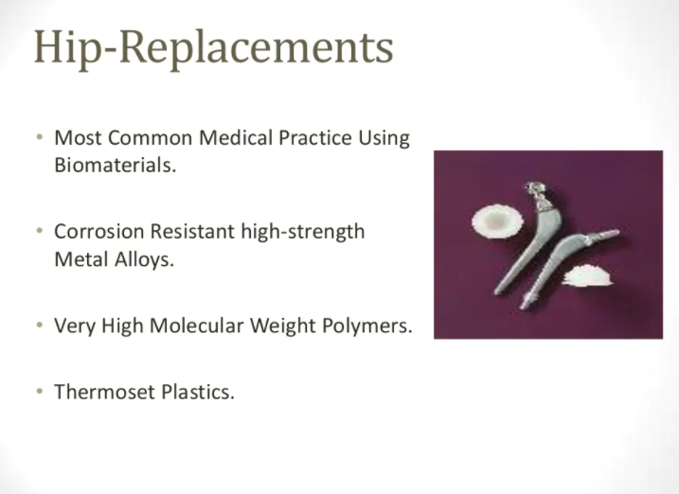

Slide 27
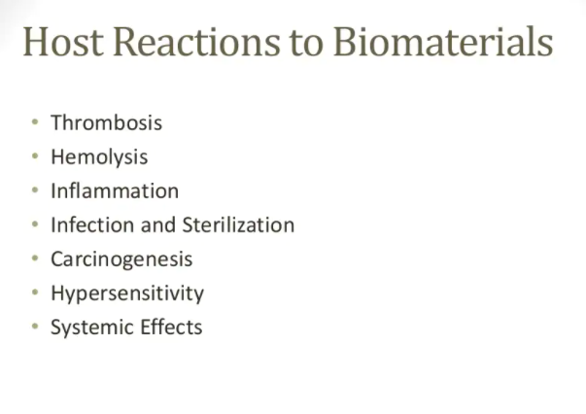

Slide 28
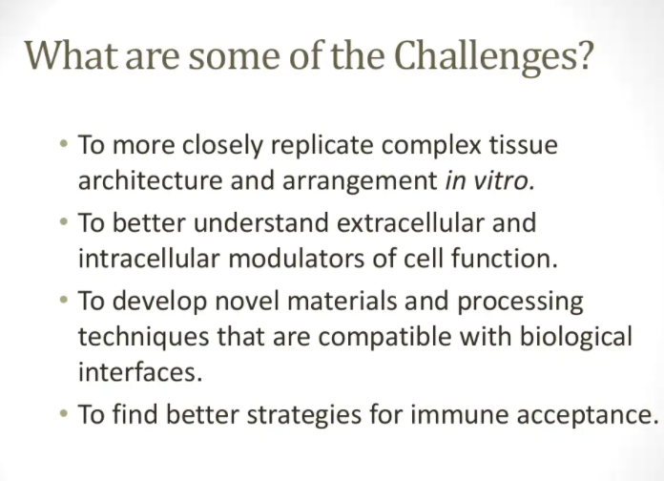

Slide 29
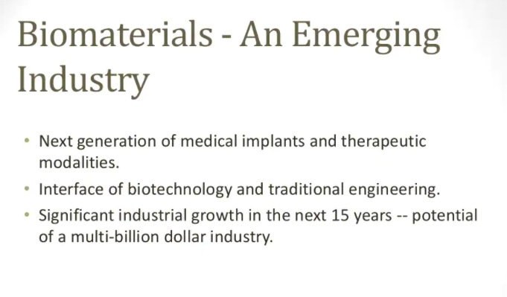

Slide 30
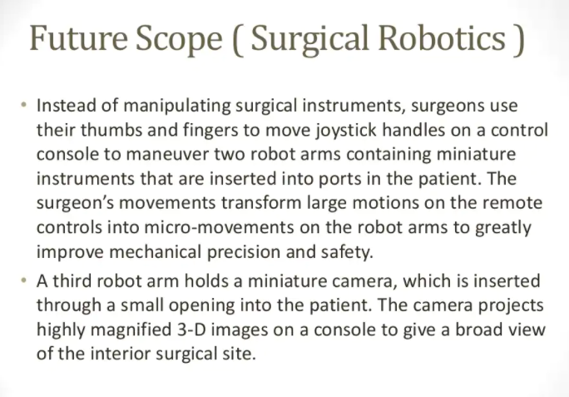

Slide 31
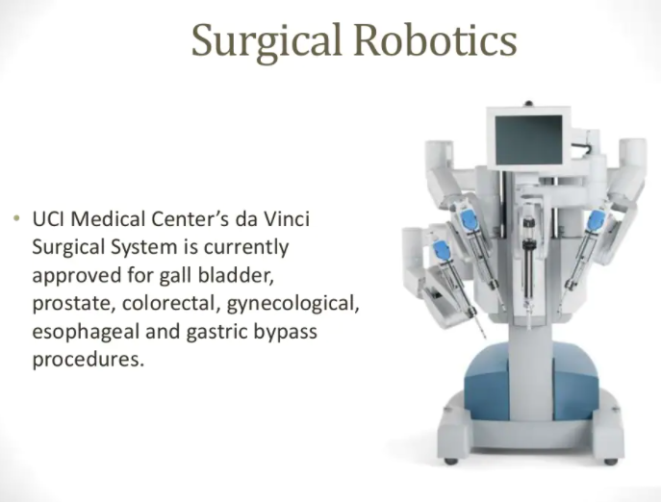

Slide 32
Hydrogels

Slide 33
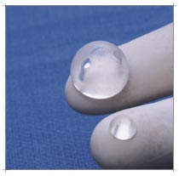
What is a Hydrogel?
Water swollen polymeric structures cross-linked together.
Cross-links produced through:
Chemical reaction to form covalent bonds
Entanglement of polymers
Hydrogen bonding and van der Waals forces

Slide 34
Classification of Hydrogels
Homopolymer
Copolymer
Multipolymer
Interpenetrating
A polymeric network is allowed to swell in another monomer.
Neutral
Anionic
Cationic
Ampholytic

Slide 35
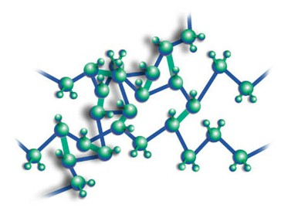
How they’re made.
Can cross link polymers via:
Heat
Pressure
Chemical reaction
Photopolymeriziation
Use light UV, visible
Radiation
Electron beams
Gama rays
X-rays

Slide 36
Uses
Biomaterial, coatings for medical devices, contact lenses
Biologically compatible
Drug delivery
Degradable, swelling properties
Many other biological applications
Develop human tissues
Food- Jello

Slide 37
POLYMERS

Slide 38
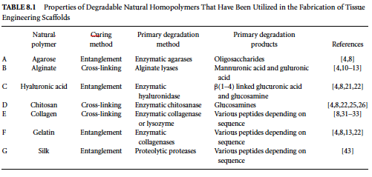
NATURAL POLYMERS For Scaffold Fabrication

Slide 39
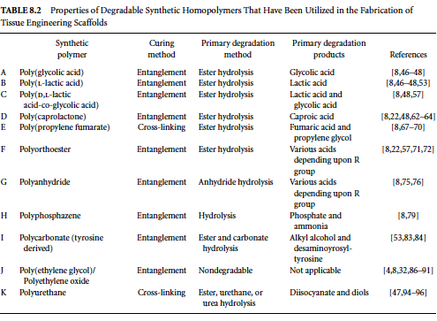
SYNTHETIC POLYMERS for Scaffold Fabrication

Slide 40
SCAFFOLD DESIGN PROPERTIES
Fabrication
Micro-Structure
Macro-Structure
Biocompatibility
Biodegradability
Mechanical Strength
FABRICATION:
Curing – Assembling polymer to form a bulk material for application.
Curing types: Polymer entanglement, Polymer crosslinking
Crosslinking
Involves the formation of covalent or ionic bonds.
A Radical or an ion is required to form cross-linked polymers.
Adv. Is high mechanical strength.
It can be injected into tissue and cured in-situ.
Disadv. – cytotoxic, due to byproducts
Entanglement
Intertwining long, linear polymer chain to form loosely bound polymer network.
Advantage is its simple
Can be formed by heat, pressure or both.
Disadvantage is lacks mechanical strength.

Slide 41
SCAFFOLD DESIGN PROPERTIES
Microstructure
Fabrication
Micro-Structure
Macro-Structure
Biocompatibility
Biodegradability
Mechanical Strength
Most cells are anchorage dependent – scaffold should aid cell growth.
Large surface area is required.
It should be porous to allow cells to infiltrate void areas.
Scaffold should possess a large surface area to volume ratio.
Macrostructure
Shapes of scaffold. i.e.. Fiber meshes, hydrogels and foams.
Fiber meshes – weaving or knitting (large surface area).
Fiber mesh mimics natural ECM.
Disadv. – lacks structural stability.
Hydrogels can absorb high volume of water and allows cells to be encapsulated.

Slide 42
Biocompatibility
Fabrication
Micro-Structure
Macro-Structure
Biocompatibility
Biodegradability
Mechanical Strength
Inflammatory response.
Should limited and not prolonged.
Three phase tissue response
I. acute and chronic inflammation. (1-2 wks)
II. Granulation of tissue, a foreign body reaction and fibrosis.
III. Bulk of scaffold is lost by degradation.
Mechanical Strength
Biodegradability
Degradation products should be removed safely.
Design a scaffold`s degradation rate so that it is quicker than the rate of degradation products removal.
To minimize negative host response.
Surface degradation
Bulk degradation.
Mechanical strength is important for weight bearing orthopedic tissues.
Mechanical properties of the polymeric scaffold should be retained until the regenerated tissue can assume its structural role.
In general hydrophobic polymers have better mechanical strength than hydropholic polymers.

